Slide 1
Smart Memory Leak Detection Utility
Madhusudanan Kandasamy
Vidya R
Lakshmanan Velusamy
Rajbir Bhattacharjee

Slide 2
Smart Memory Leak Detection Utility
There are few tools available to detect the memory leak of the application.
Most of these tools suffer from either of these shortocmings
  They require instrumentation of the application.
  They are inefficient and hence cannot be used in production environment.
  They generate report only at the end of execution and it is difficult to get incremental report of how memory is growing.
  They only provide a report, or trace statements and no other interactive way of debugging

Slide 3
Need of the hour
A light-weight memory-leak debugger that needs no binary instrumentation
That provides interactive debugging capabilities
That can show incremental growth of memory based on user-choice

Slide 4
Memory Leak Debug Assistance
Developed as a plugin to dbx, hence fully interactive debugging capabilities present
Extremely light-weight and has no performance impact. Can be used in a production environment
Requires no instrumentation of binary
Can generate incremental reports, and can store multiple incremental reports, along with the stack-trace and growth information
Can attach to a process that is already running and leaking memory

Slide 5
Commands
checkpoint – Creates a checkpoint of all the active allocations at that point. A maximum of 16 checkpoints are saved (in indexed manner) by the plugin
diff <i> <j> - Generates a report of how much memory was allocated and freed between checkpoint i and checkpoint j (i, j <= 16). Allocations and frees from the same function stack and of the same size are aggregated.

Slide 6
Example 1: Simple application
Start
Checkpoint
Break at exit()
Continue
Checkpoint
diff
stop

Slide 7
Example 2: Work function in a loop
Start
Attach to the app
Checkpoint
Breakpoint at work()
Checkpoint
diff
Found Leak?
N
Stop
Y

Slide 8
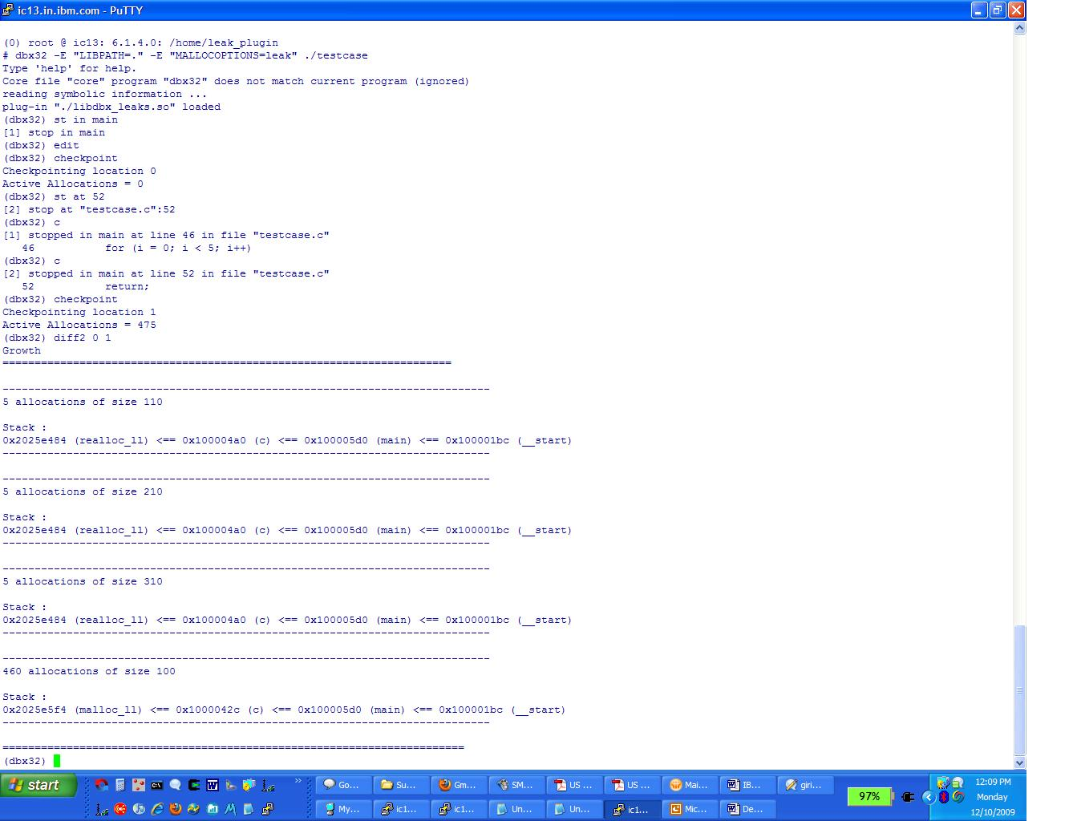
ScreenShot

